Slide 1
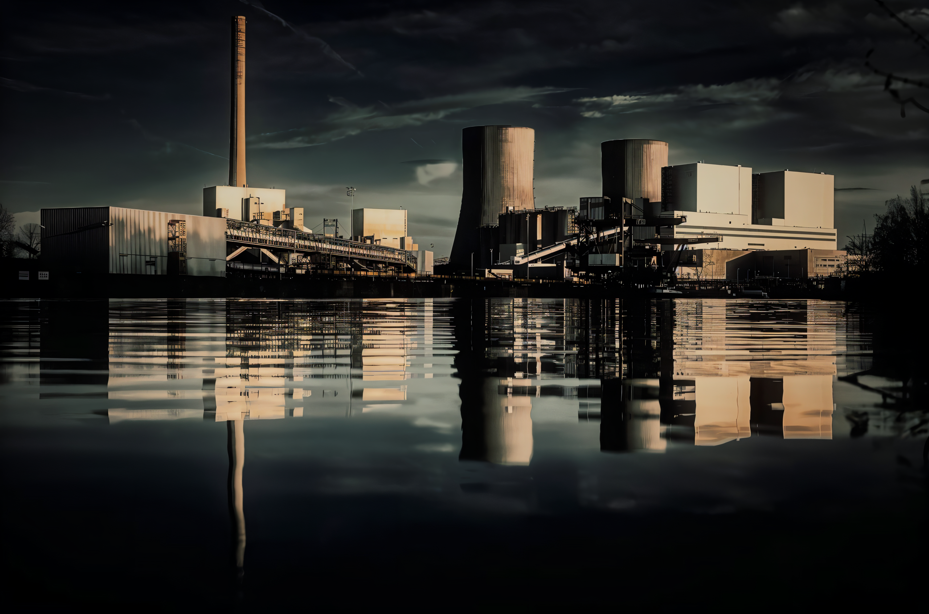


Slide 2
1. INTRODUCTION
The Faridabad Combined Cycle Power Plant, also known as NTPC Faridabad, is located near village Mujedi and Neemka in Faridabad, Haryana, India.
The power plant is one of the Gas-based power plants owned by NTPC.
The gas for the power plant is sourced from GAIL HBJ Pipeline.
Source of water for the power plant is Rampur Distributories of Gurgaon canal.

Slide 3
Installed Capacity of at least 431MW.
It has 2 Gas Turbine (GT) of Capacity 138 MW and Steam Turbine (ST) of Capacity 156 MW.
In Power Plant Fuel used :
1. Main Fuel - Natural Gas
2. Alternative Fuel - Naphtha
- High Speed Diesel .
Amount of Material Usage in Plant :
1. Natural Gas – 6.79 kg/sec
2. Naphtha – 6.58 kg/sec
3. Water – 700 tone / hr / unit

Slide 4
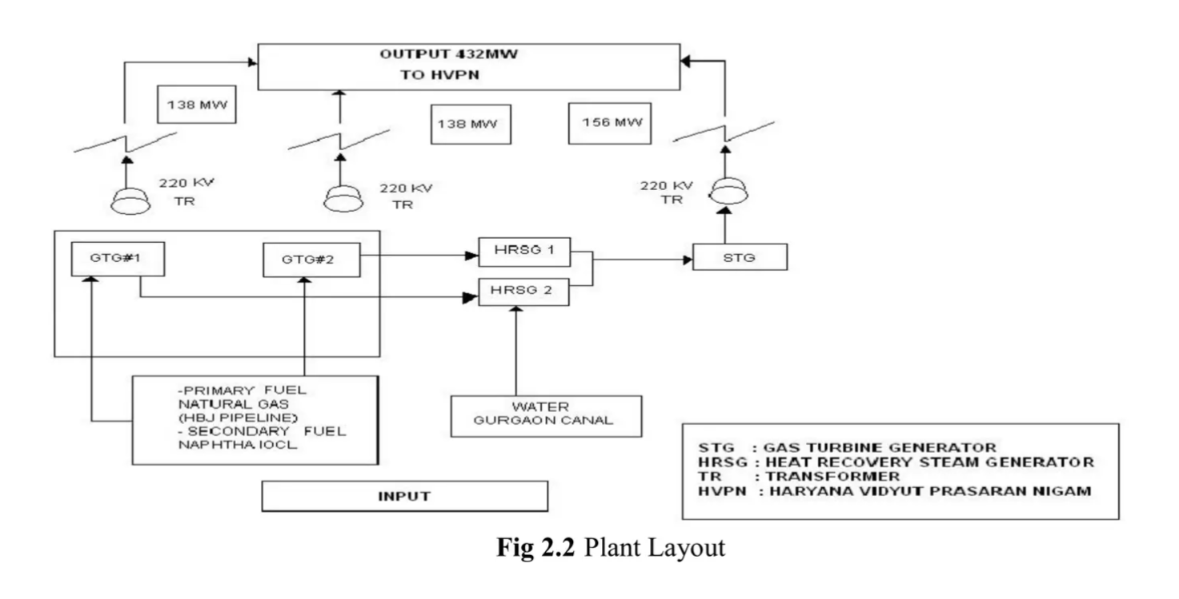
10.5 KV
15.75 KV

Slide 5
2. Operational detail
Cost of Generation – ₹ 4.5 - 7.5 per Unit (kWh)
Mode of Operation – Peak Load
Rated Terminal Voltage – 10.5 KV for GT
– 15.75 KV for ST
4. Rated Output – 135 MVA for GT
– 191.6 MVA for ST
5. Rated Speed – 3000 rpm
6. Type of Cooling – Closed Cycle Water System for STG
– Air Cooling System for GT 1 & 2
7. Black Start Facility – 3.3 MW Diesel Generator
with rated Speed of 2000 rpm .

Slide 6
7. Natural gas contain primarily Methane (CH4) ,
Ethane (C2H6) , Nitrogen (N2) , Carbon dioxide
(CO2) and Sulphur (S)
8. This gas Come from Bombay High through Medium
pipelines and one from village of Chhainsa .
9. It also Have 5MW of Solar photo-voltaic plant at
Jhajur Village near Faridabad .
If Plant is OFF then it Receive Supply from Grid
of Samaypur else Supply to Palla and Sec 78.
11. The startup time for gas turbine take 15 to 20
min and for steam turbine 5 to 10 hrs to reach its
rated power.

Slide 7
3. Fuel
Several factors depend for selection of fuel. Natural gas is an ideal fuel. Liquid fuels particularly heavy oils; which cause corrosion and may leave deposits in gas turbine, which reduces the performance and adds to the maintenance cost.
The dual fuel system enables to switch the operation mode (fuel mode) to change over between Normal Operation (Natural Gas) and Emergency Operation (Naphtha or HSD) without the gas turbine to be stopped.

Slide 8
4. Mechanical System
The main generating unit is consists of three main equipment's . They are :
1. Gas Turbine
2. Heat Recovery Steam Generator
3. Steam Turbine

Slide 9
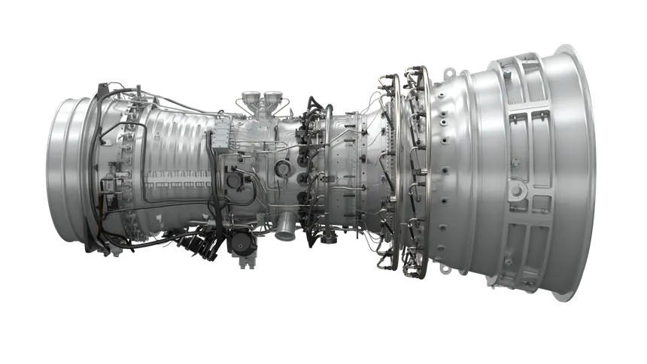
4.1 Gas Turbine
A gas turbine is a combustion engine that converts the energy from a fuel into mechanical work through a process called the Brayton cycle. Atmospheric air flows through a compressor, then fuel is sprayed into the air and ignited in combustion chamber, It creates hot, high-pressure gas that spins a turbine which produce electricity.

Slide 10
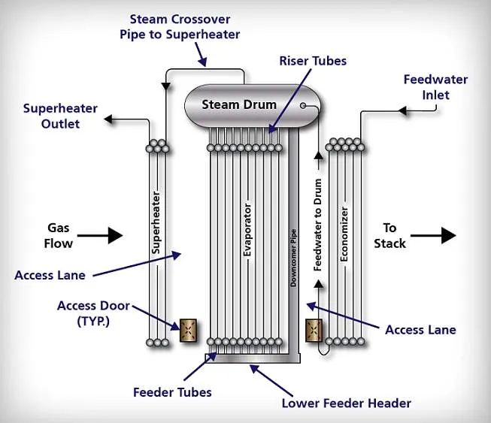
4.2 Heat Recovery Steam Generator
HRSG is a heat exchanger that recovers heat from a hot exhaust gas and produces steam that can be used to drive a steam turbine.
It has 4 Major components :
1. Economizer
2. Evaporator
3. Superheater
4. Steam Drum

Slide 11
The Economizer preheats the feedwater before it enters Evaporator, increasing the efficiency of the HRSG by reducing heat loss.
The Evaporator converts water into steam. It heats water that falls from the steam drum and converts it into saturated steam, which is then forwarded to the superheater.
The Superheater dries the saturated vapor and may superheat it to a significant temperature for additional energy storage. It is typically placed in the path of the hottest gas and upstream of the evaporator.
The Steam Drum is part of boiler that stores water steam and separates steam form the water .

Slide 12
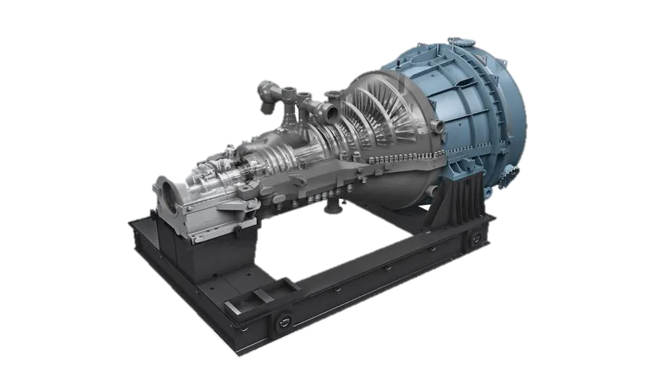
4.3 Steam Turbine
A steam turbine or steam turbine engine is a machine or heat engine that extracts thermal energy from pressurized steam and uses it to do mechanical work utilizing a rotating output shaft.

Slide 13
5. Basic Working Of Plant (Combine Cycle Power Generation)
The fuel is fed in the two turbines.
The fuel is burnt in the gas turbines to release the flue gases at high pressure and temperature. These gases rotate the turbine shaft.
The shaft of the turbine is linked to the shaft of the gas turbine generator which leads to the production of energy at the two generators.
The flue gases produced are passed through waste heat recovery steam generators where it passes from super-heaters, evaporators, economizers and condensate preheated.

Slide 14
5. Water present and flowing in the above devices
absorb heat from the hot flue gases and get
converted in to high pressure and low pressure
steam.
6. The high-pressure steam from WHRSG goes to
the HP turbine and the low-pressure steam and
steam available at the outlet of HP turbine goes
to the LP turbine.
7. Steam rotates the turbine, which is connected to
the generator by a rigid coupling, making it spin
and produce electricity.

Slide 15
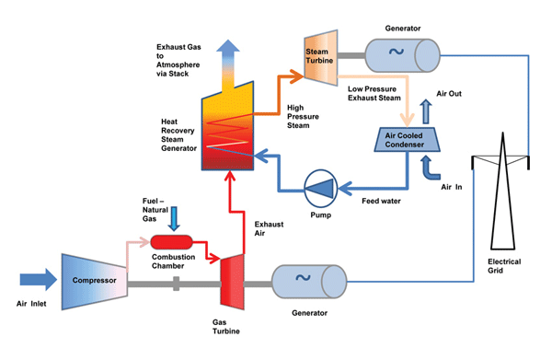
Alternator / Synchronous Generator
Main Fuel – Natural Gas
Alternative Fuel -Naphtha and HSD
(SwitchYard)
Alternator / Synchronous Generator

Slide 16
Special Thanks :
1. S.S Narula Sir
2. Rajesh Sir
3. Atul Sir
Thank You

